Slide 1
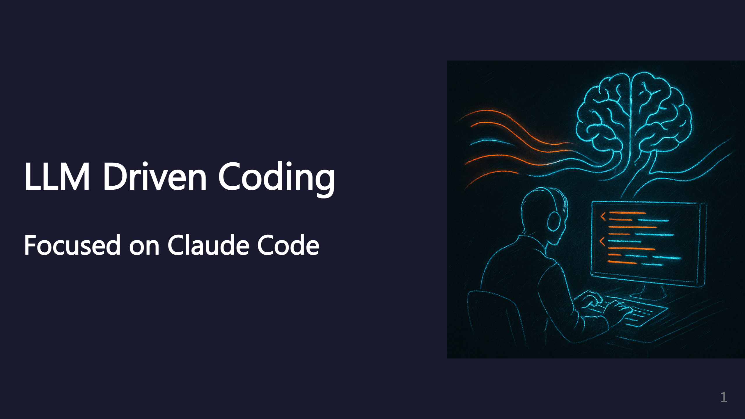
Notes:
This presentation covers LLM-driven coding practices, focused on Claude Code. I'm guessing a lot of these ideas will apply to other agents too. _transition: push

Slide 2
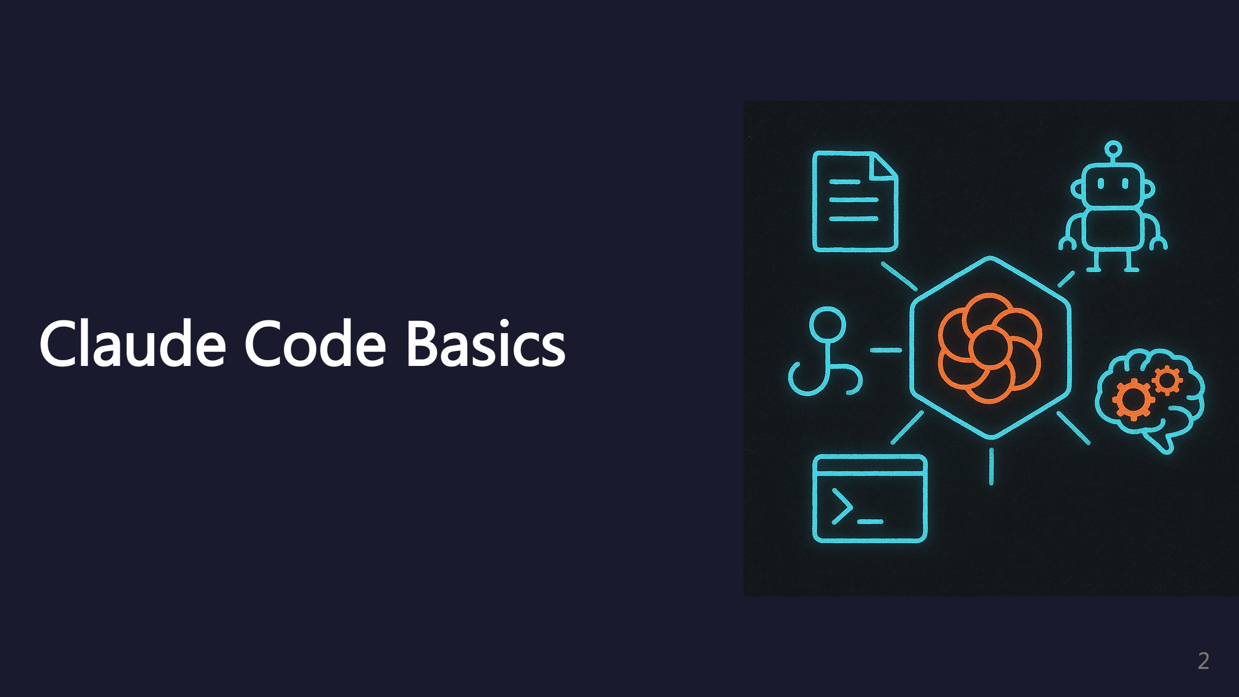
Notes:
Overview of the core Claude Code features.

Slide 3
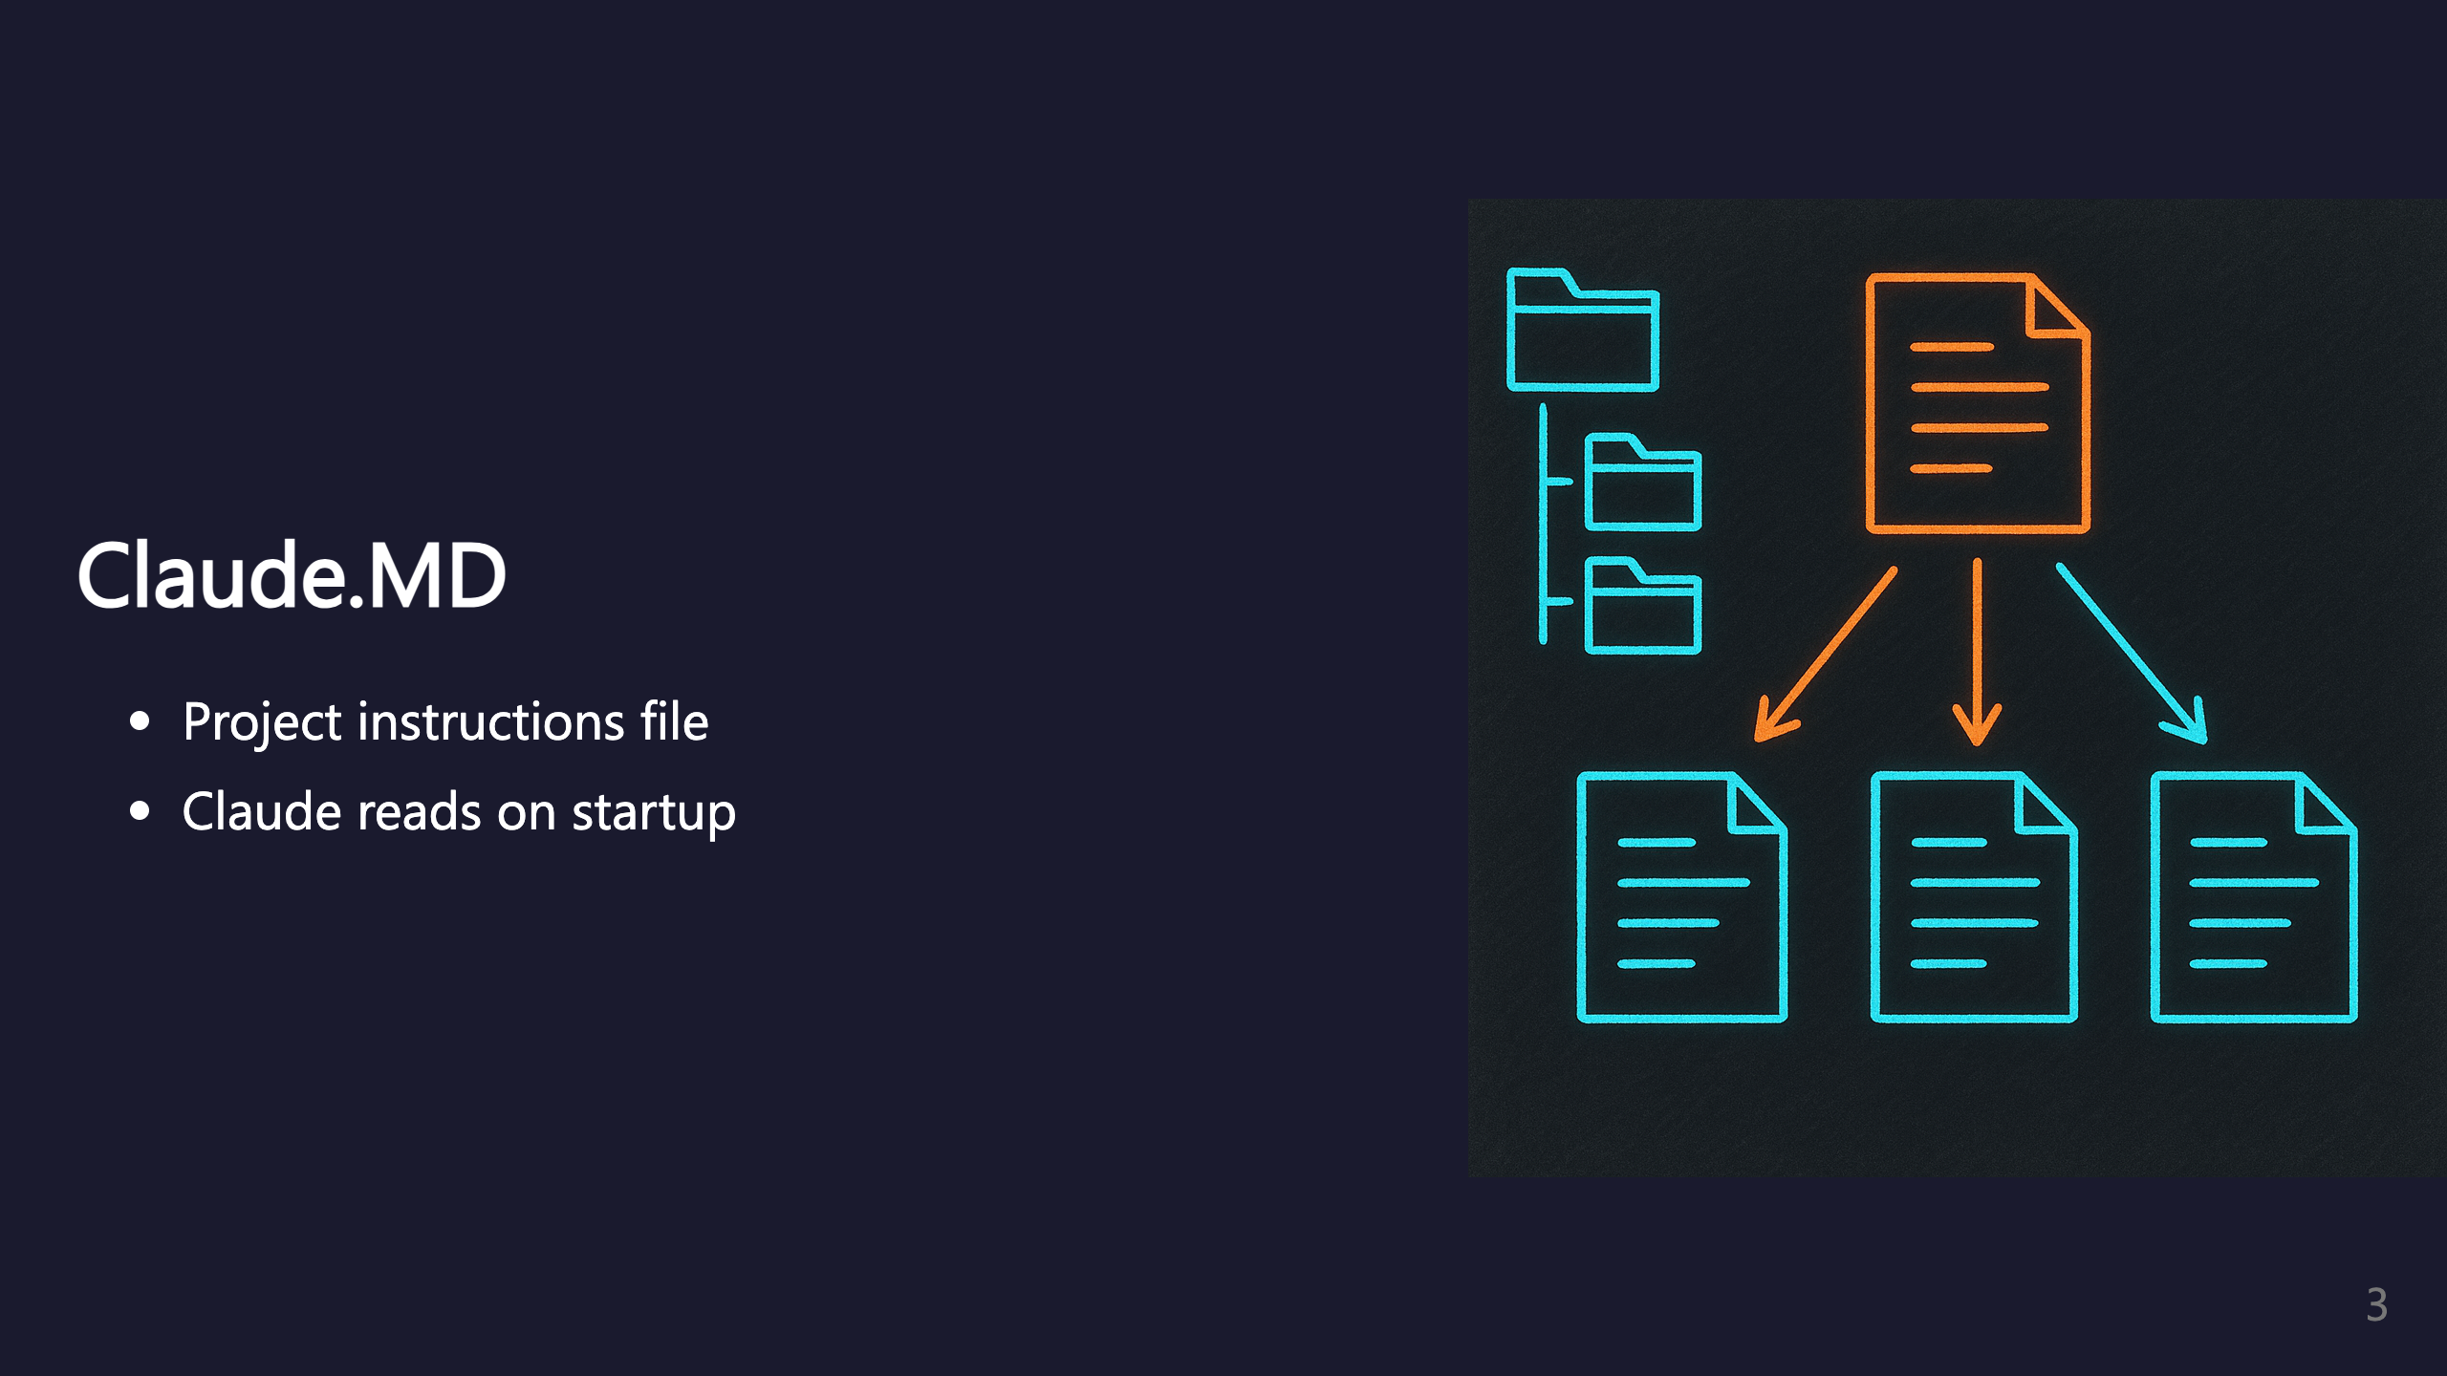
Notes:
Claude.MD is the main configuration file that Claude reads when starting a session.

Slide 4
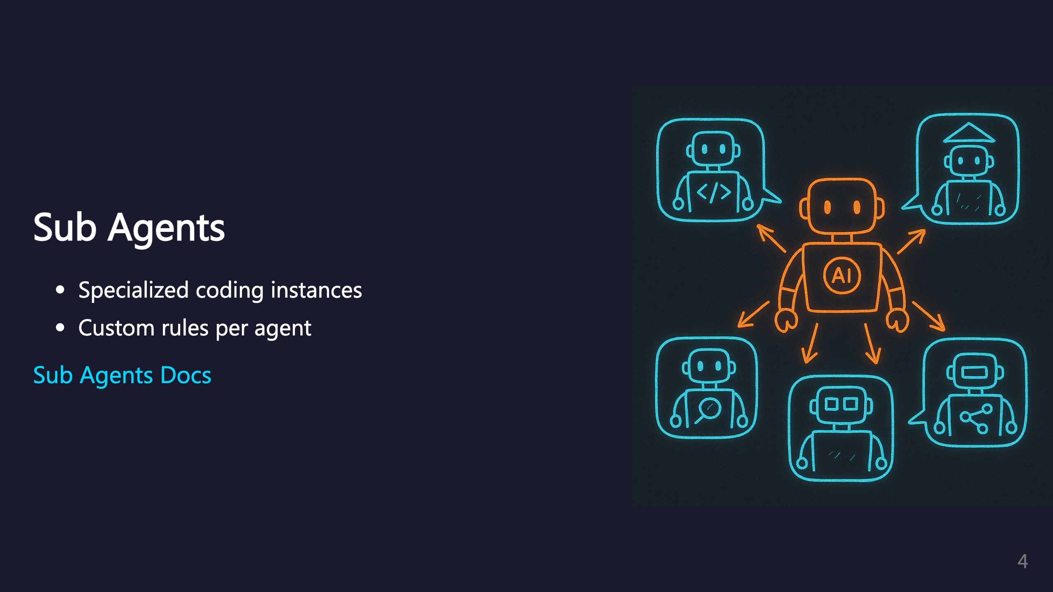
Notes:
Sub agents are specialized instances with their own custom rules and context.

Slide 5
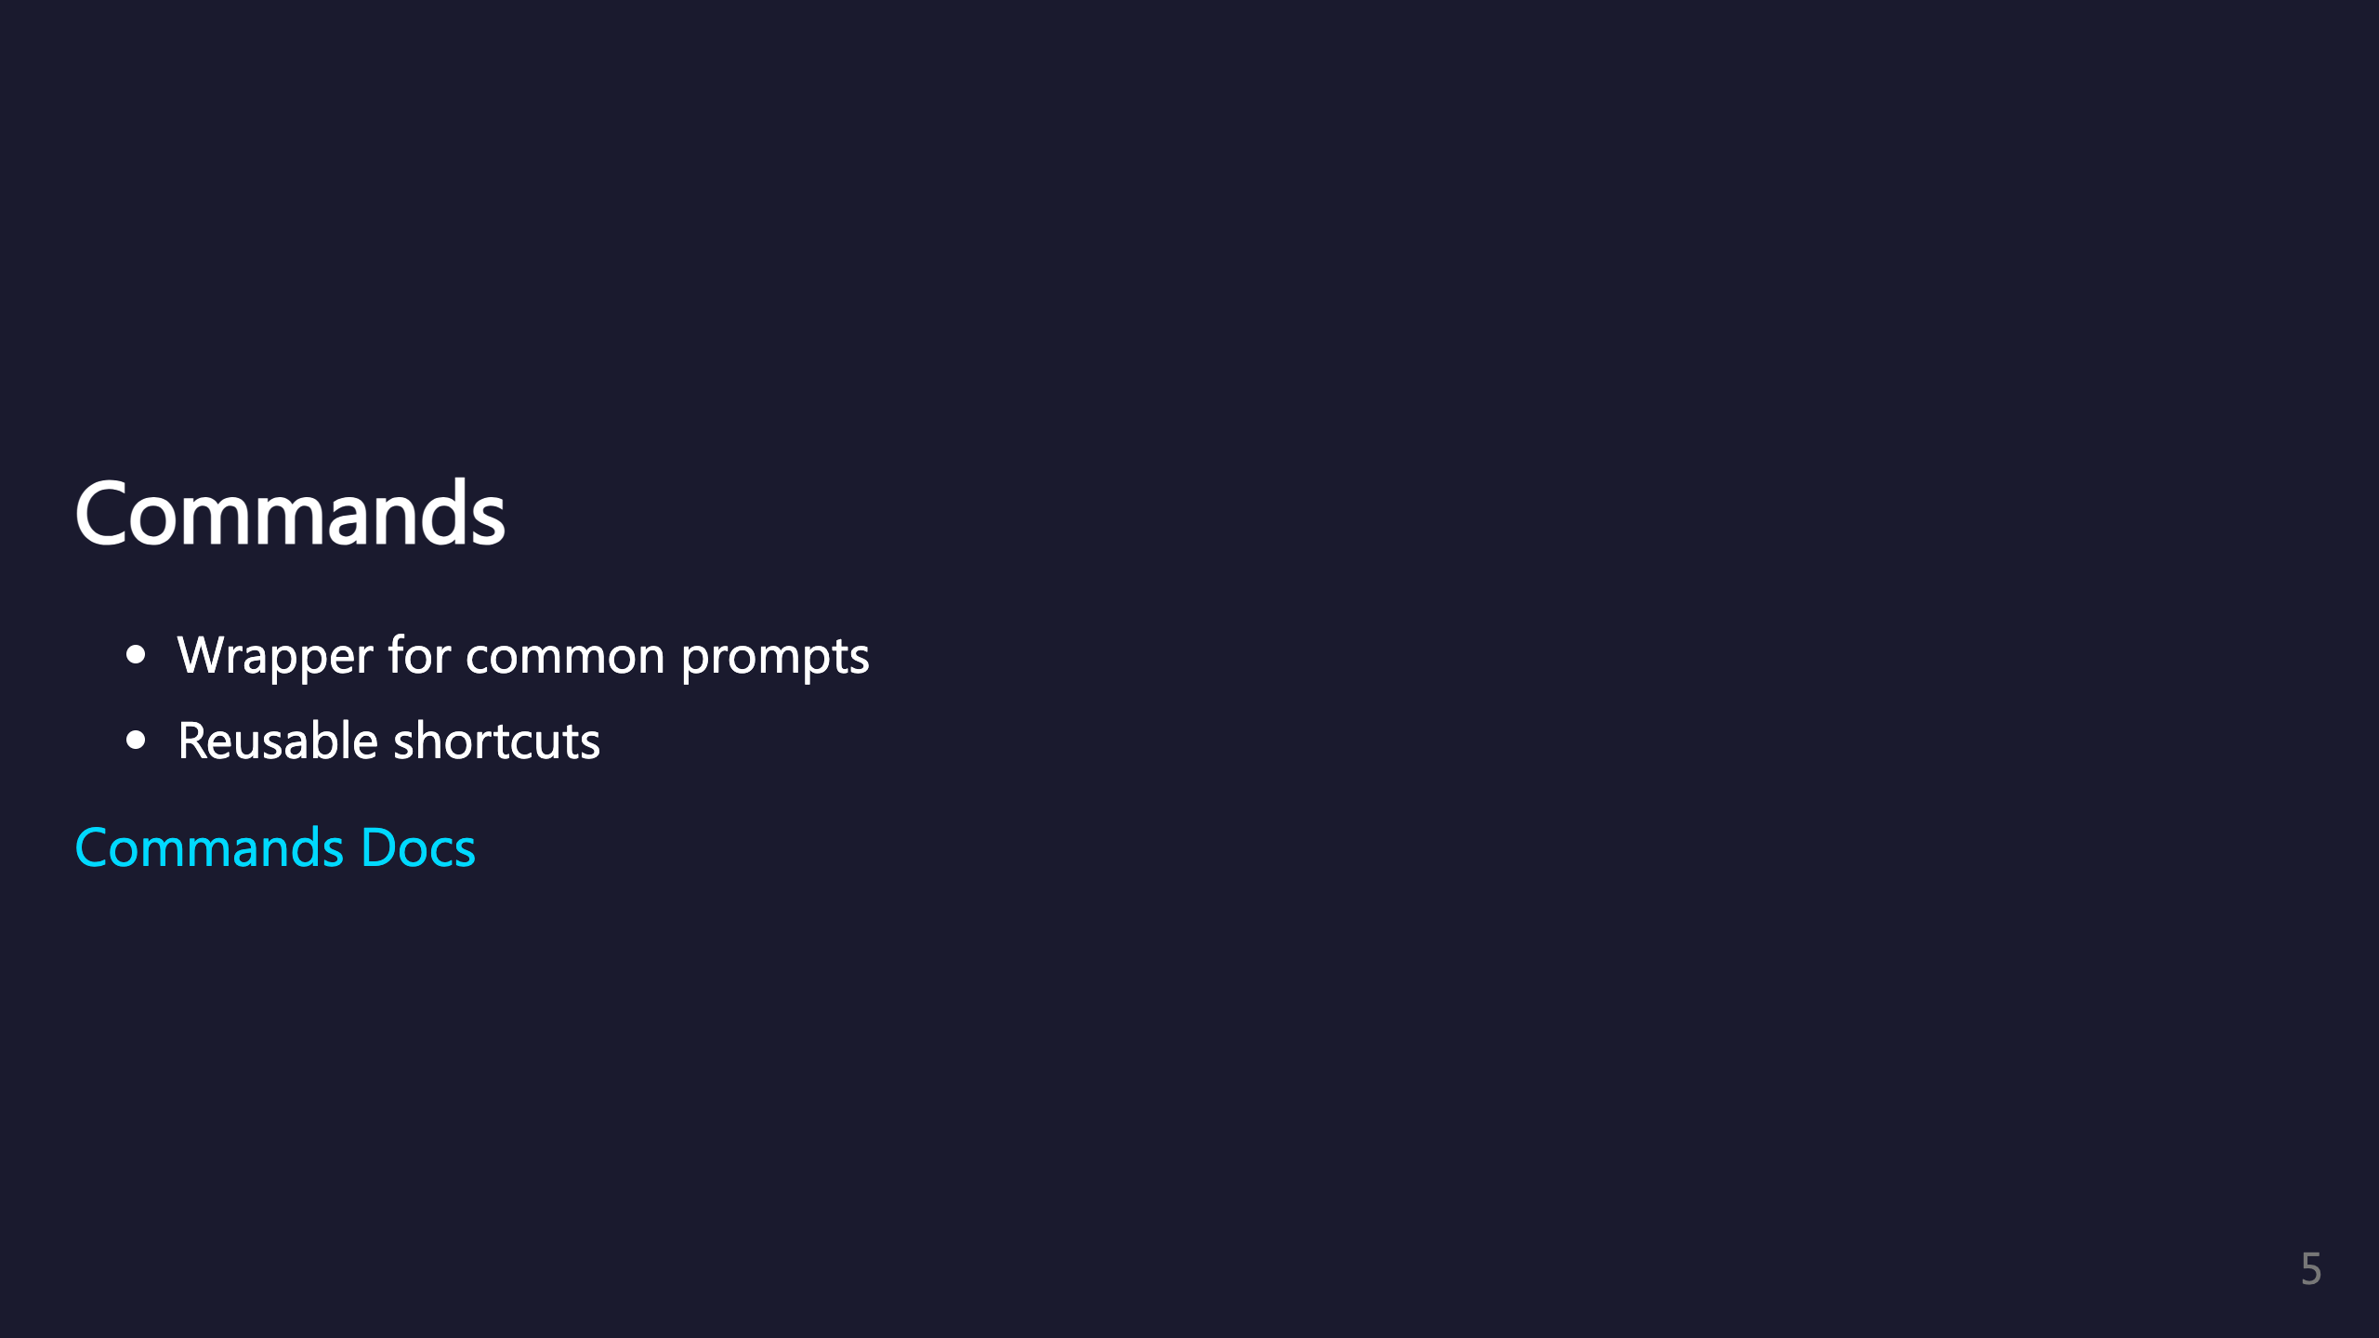
Notes:
Commands let you create shortcuts for commonly used prompts.

Slide 6

Notes:
Skills extend Claude with custom information that Claude uses when it thinks it's necessary.

Slide 7

Notes:
Hooks are callbacks that trigger on specific events during Claude's operation. _transition: push

Slide 8

Notes:
Here's how I configure my Claude Code environment.

Slide 9
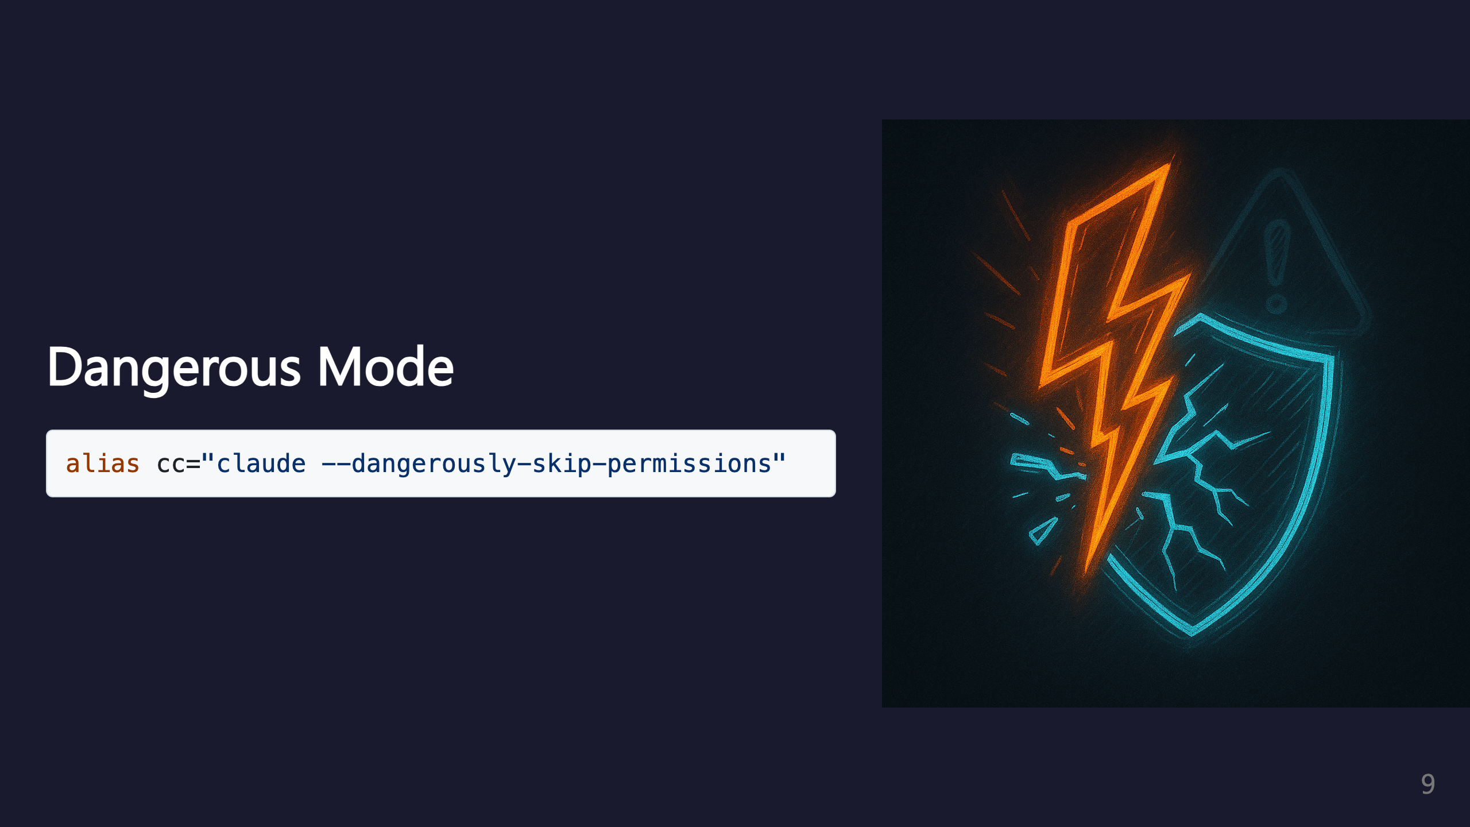
Notes:
This alias skips permission prompts for faster iteration. Use with caution - only in trusted projects.

Slide 10
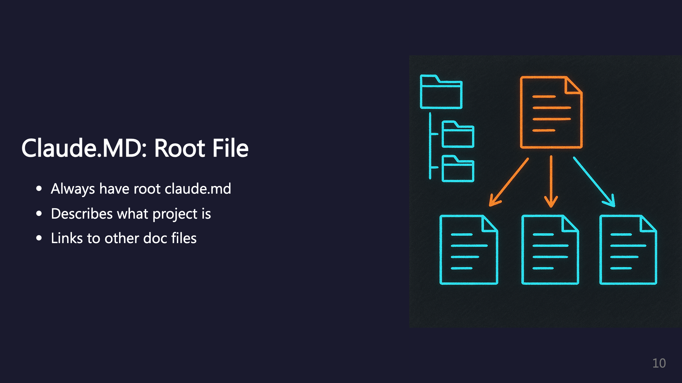
Notes:
The root claude.md should be the entry point that describes the project and links to other documentation. See: https://code.claude.com/docs/en/memory#claude-md-imports

Slide 11
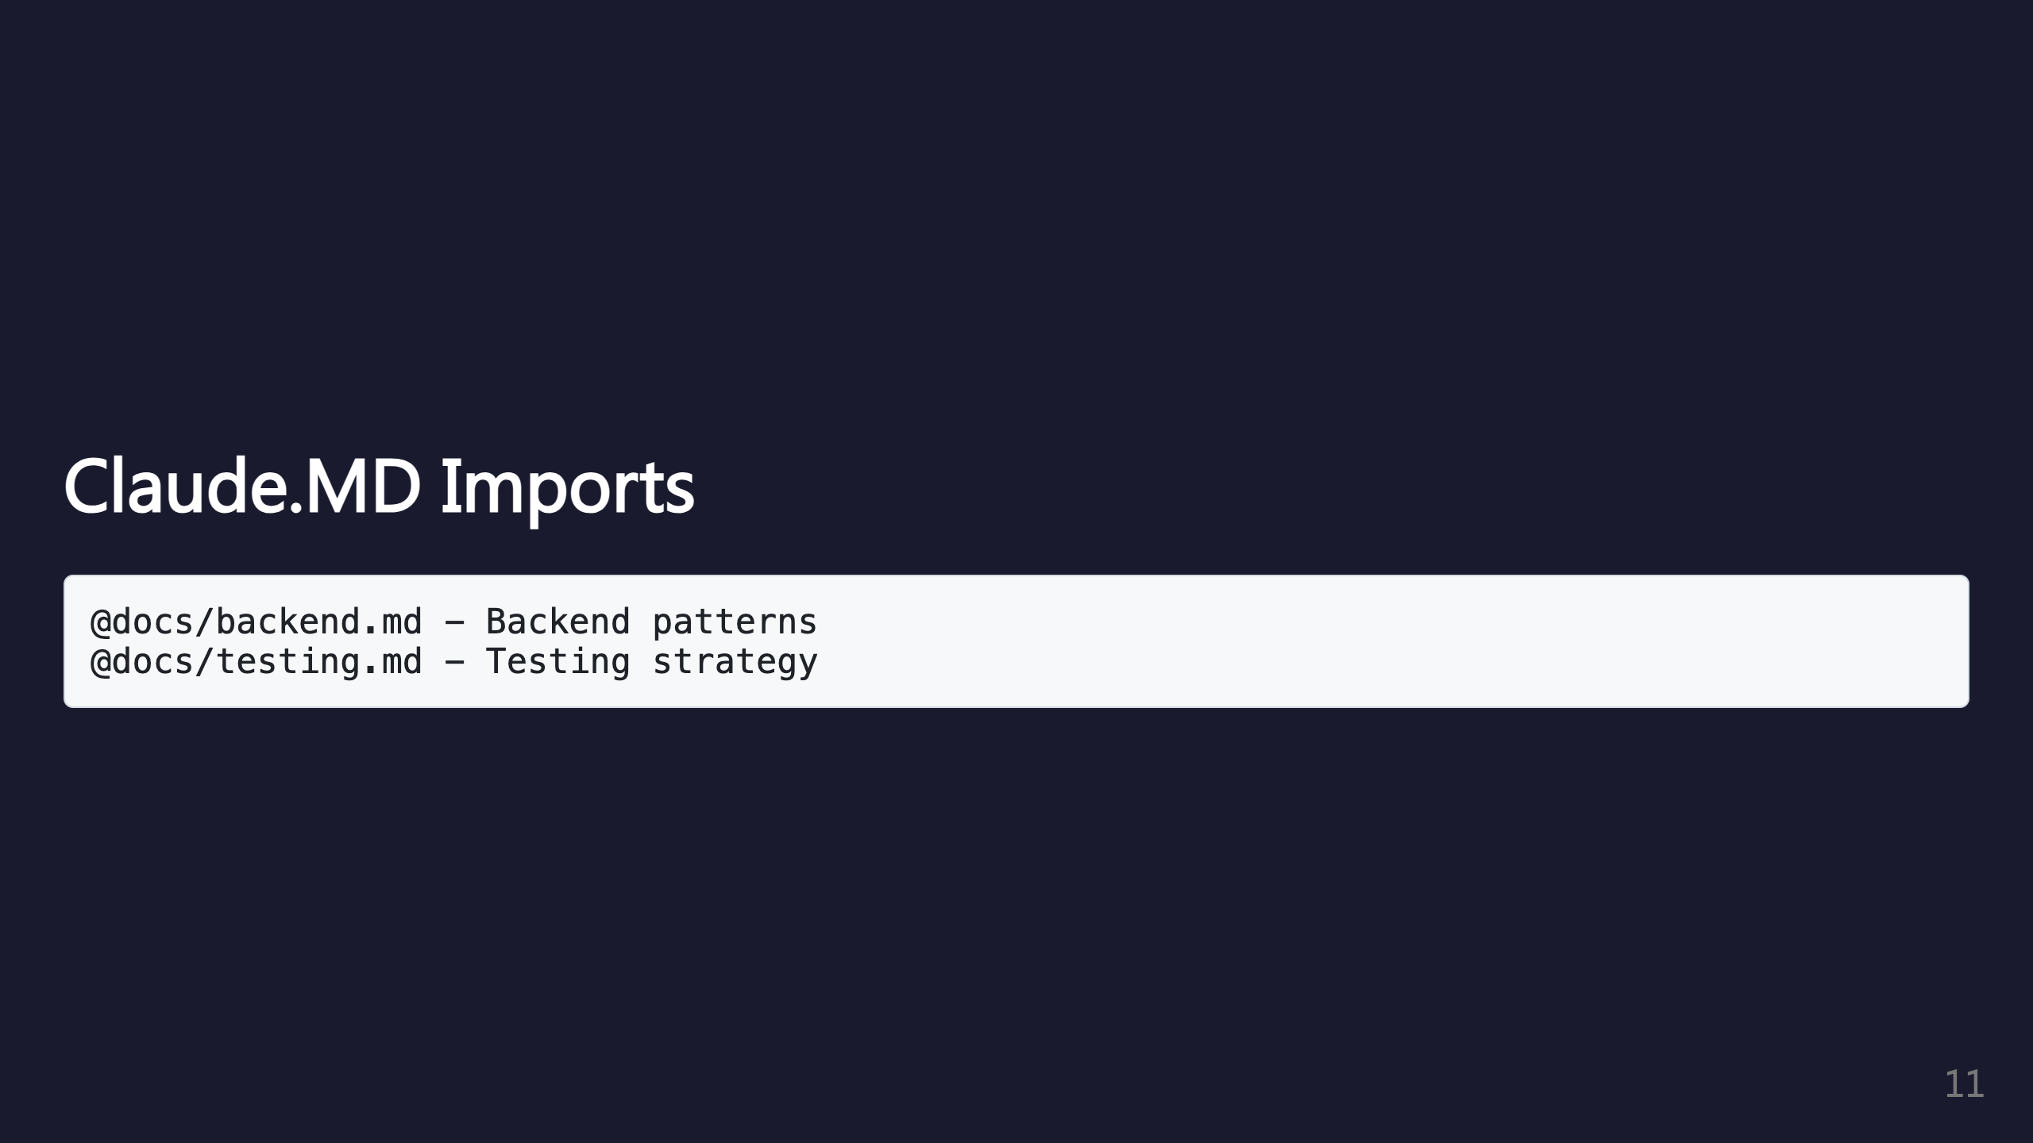
Notes:
You can import other markdown files to keep documentation modular.

Slide 12
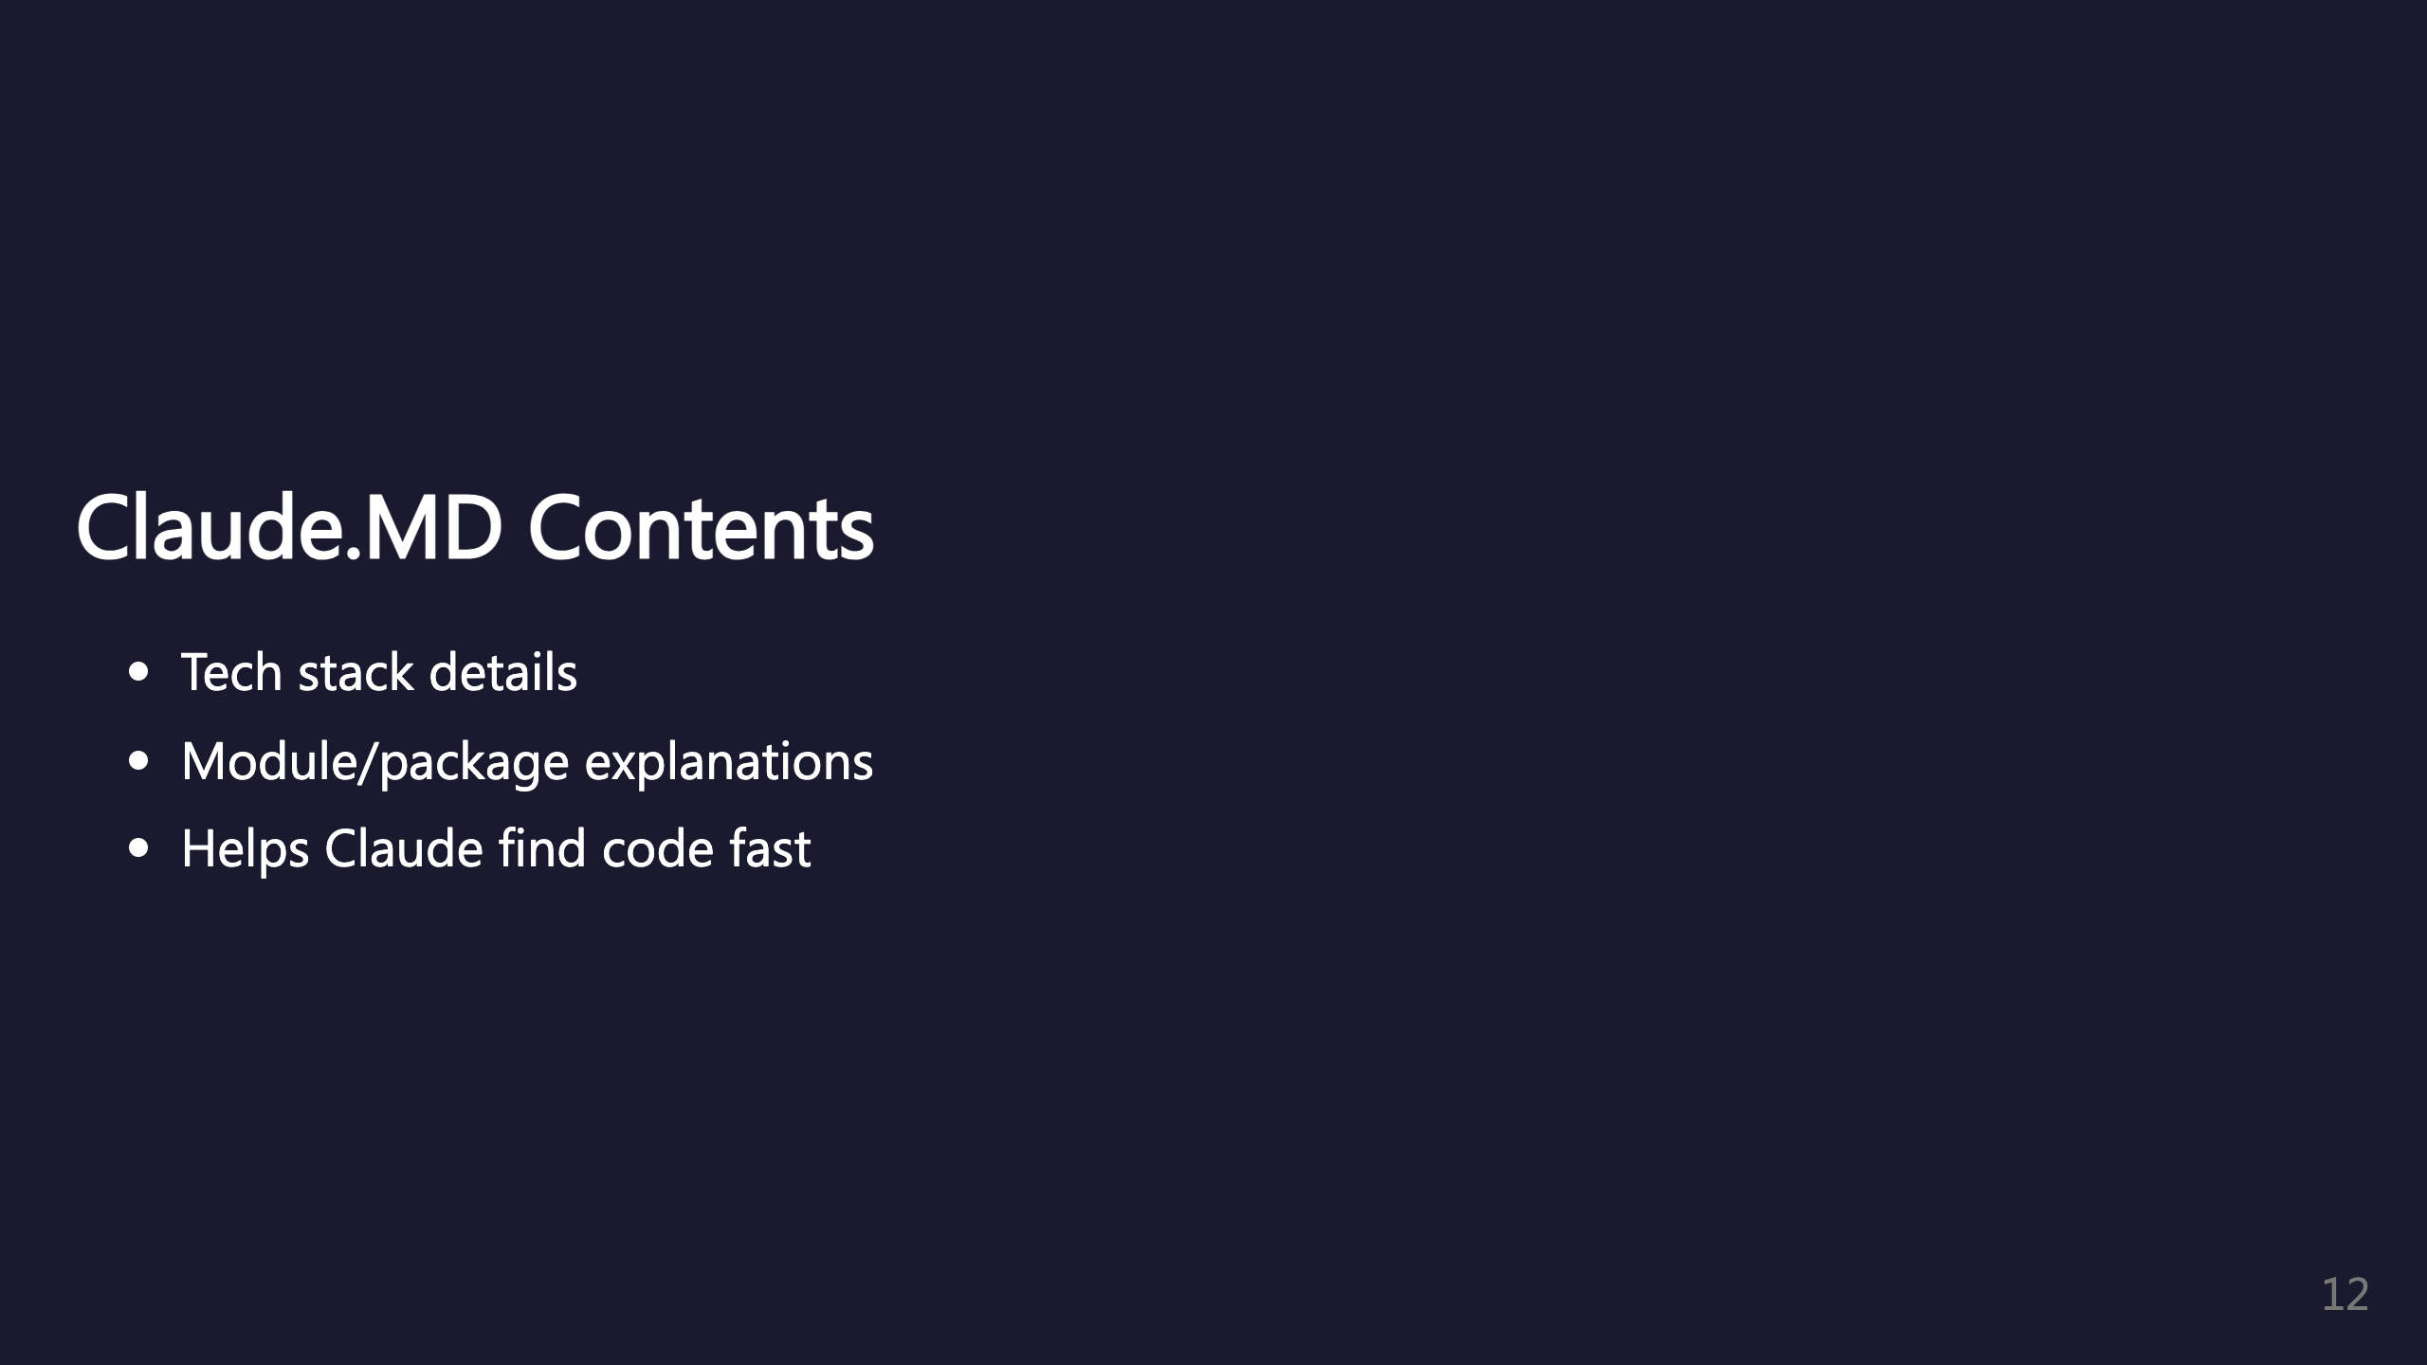
Notes:
Explain each module and package so Claude can quickly identify where to put what.

Slide 13
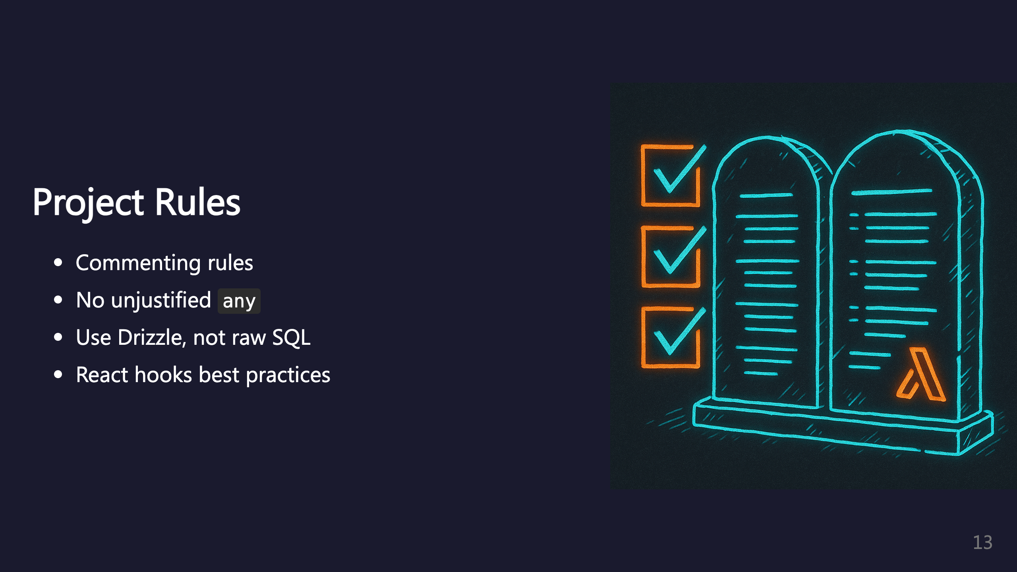
Notes:
Include rules like: - TypeScript type safety (no unjustified any) - Use Drizzle ORM syntax instead of raw SQL - Proper useMemo, useCallback usage

Slide 14
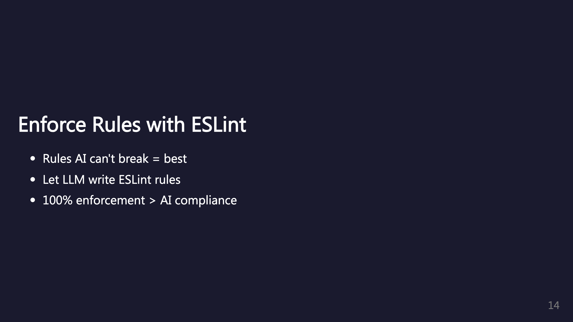
Notes:
Any rule that can be enforced 100% will always be better than expecting AI to follow rules. ESLint rules are great for this. Why not have the LLM write more ESLint rules?

Slide 15
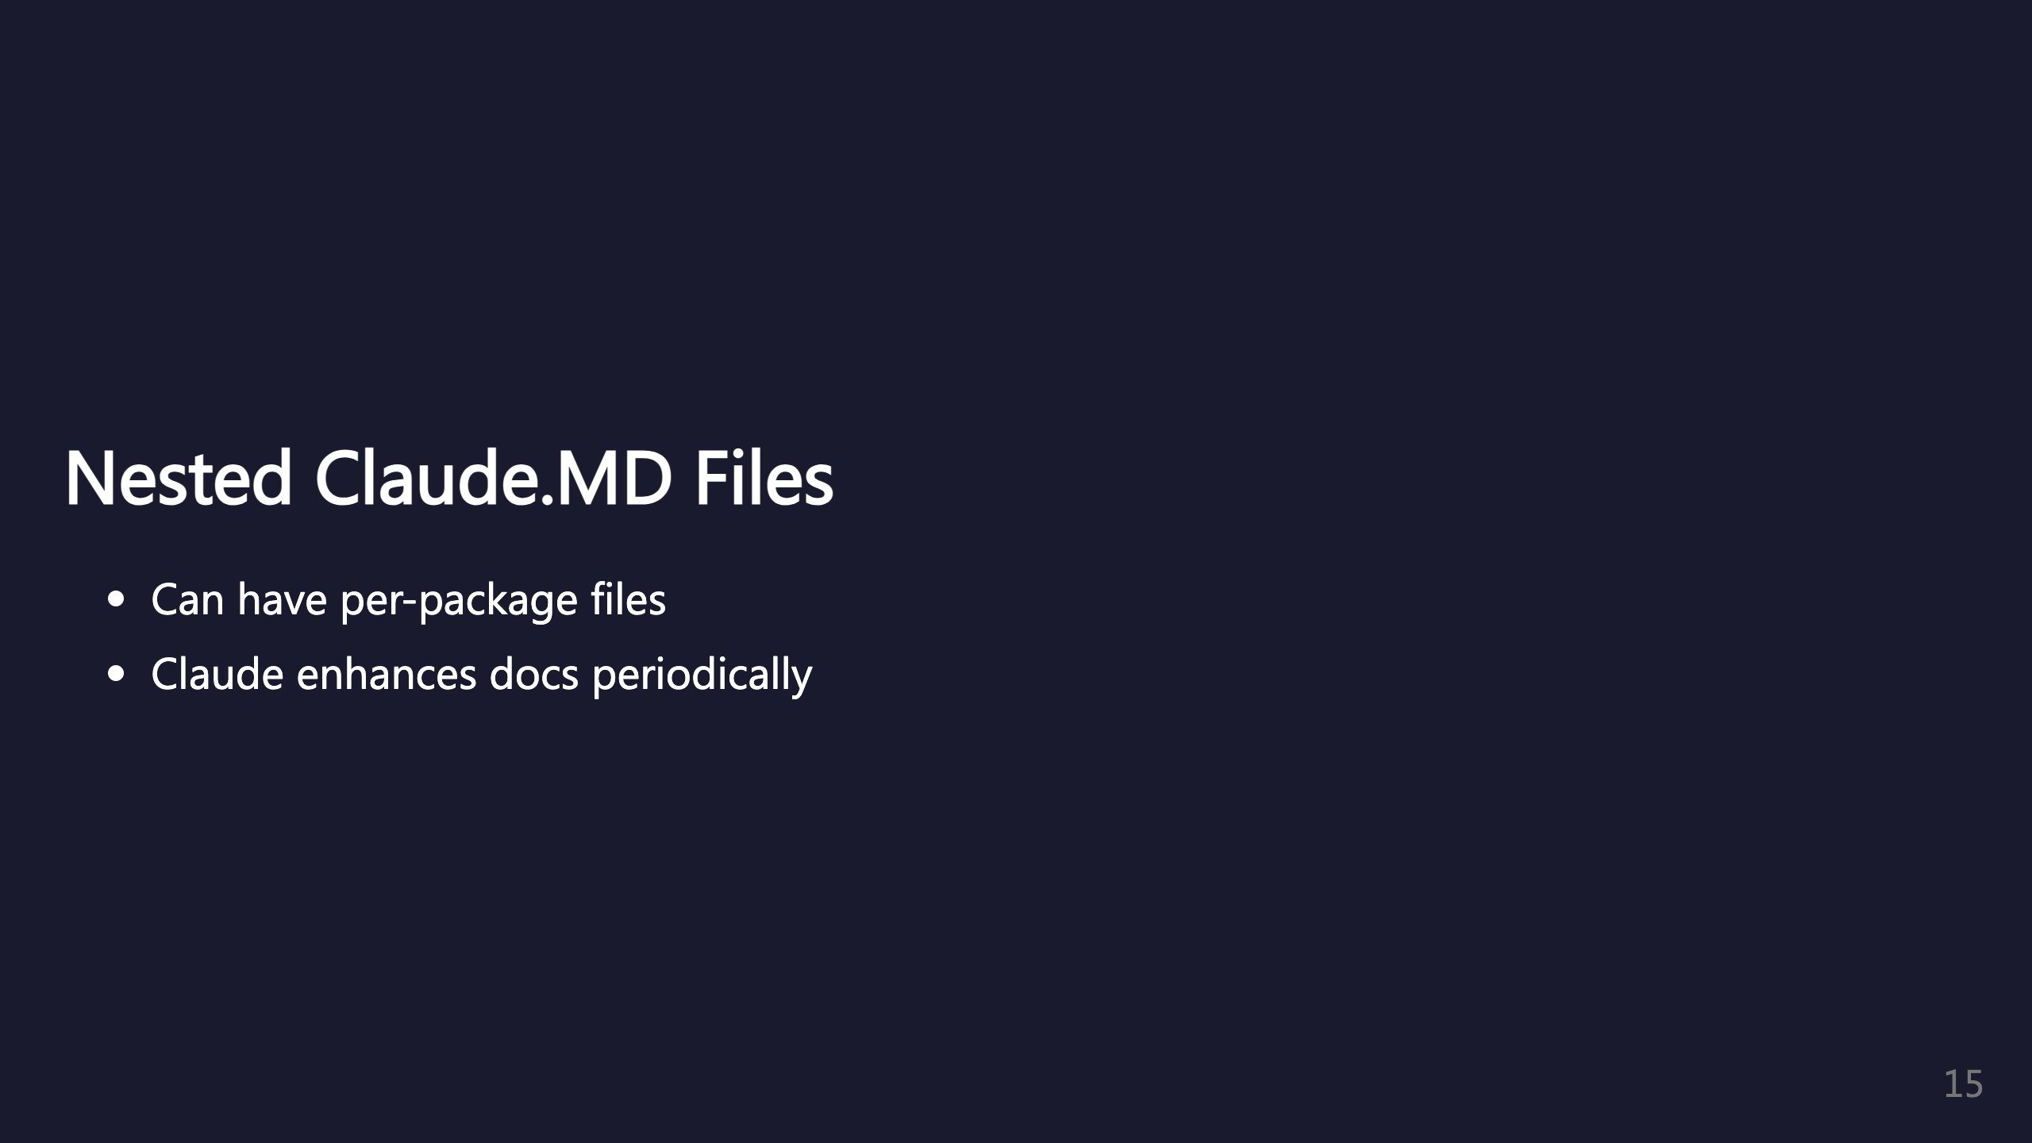
Notes:
You can have claude.md in each package/subfolder. Periodically get Claude to double-check and enhance the docs. _transition: push

Slide 16

Notes:
Deep dive into sub agents configuration.

Slide 17
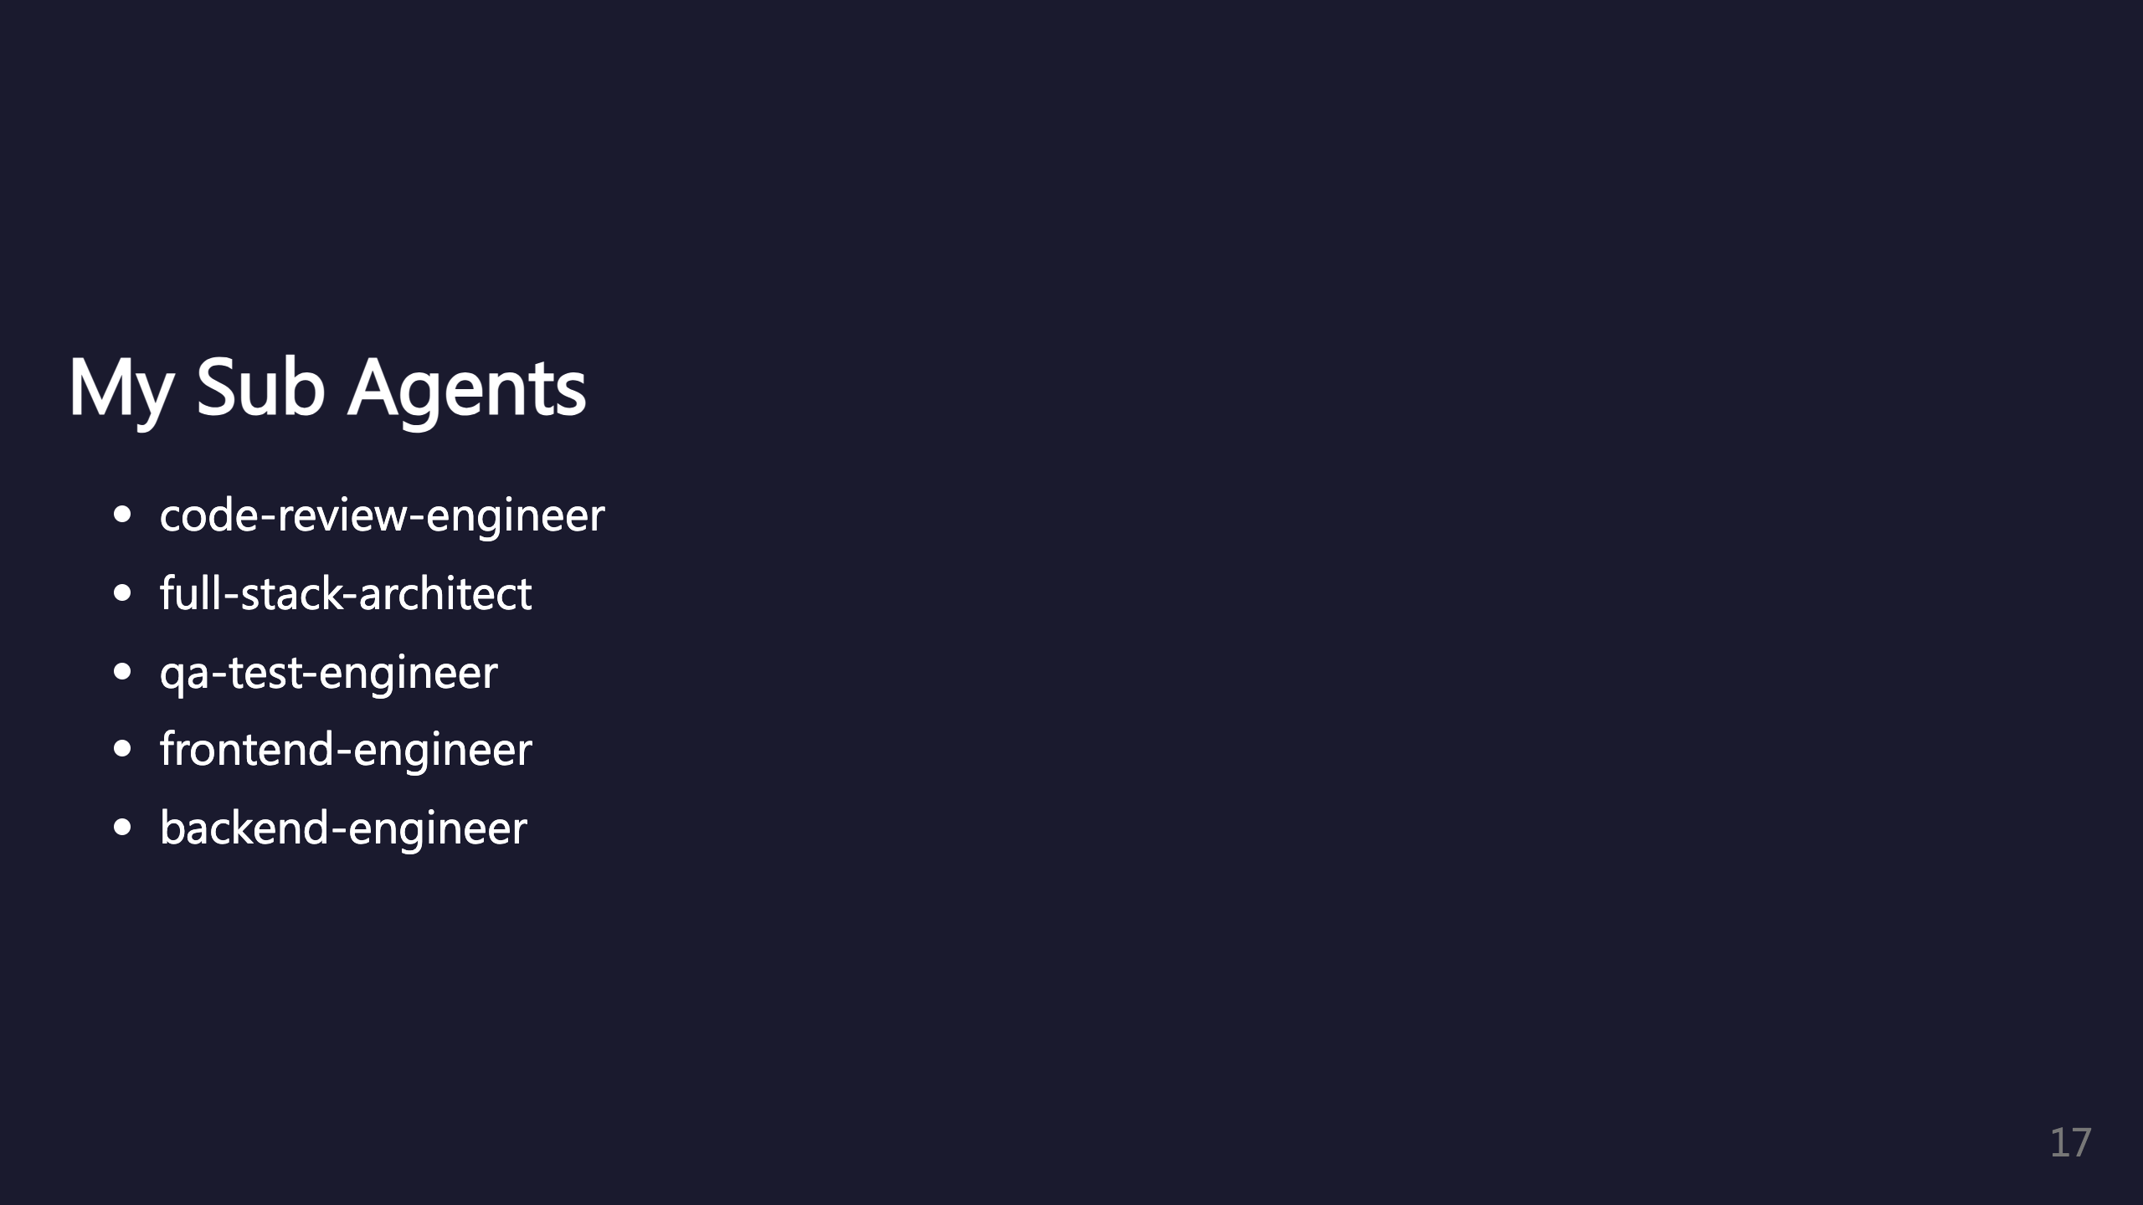
Notes:
Example agent list from /agents command showing project-level agents. Also plugin agents like superpowers:code-reviewer.

Slide 18
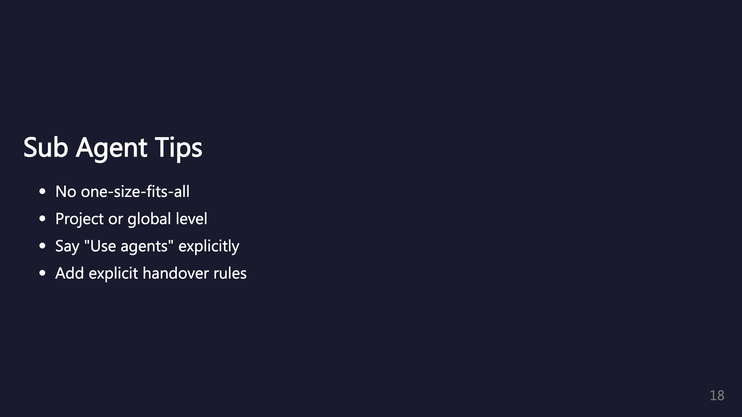
Notes:
Customize to what works for your project. Claude is meant to use agents automatically but it helps to be explicit.

Slide 19
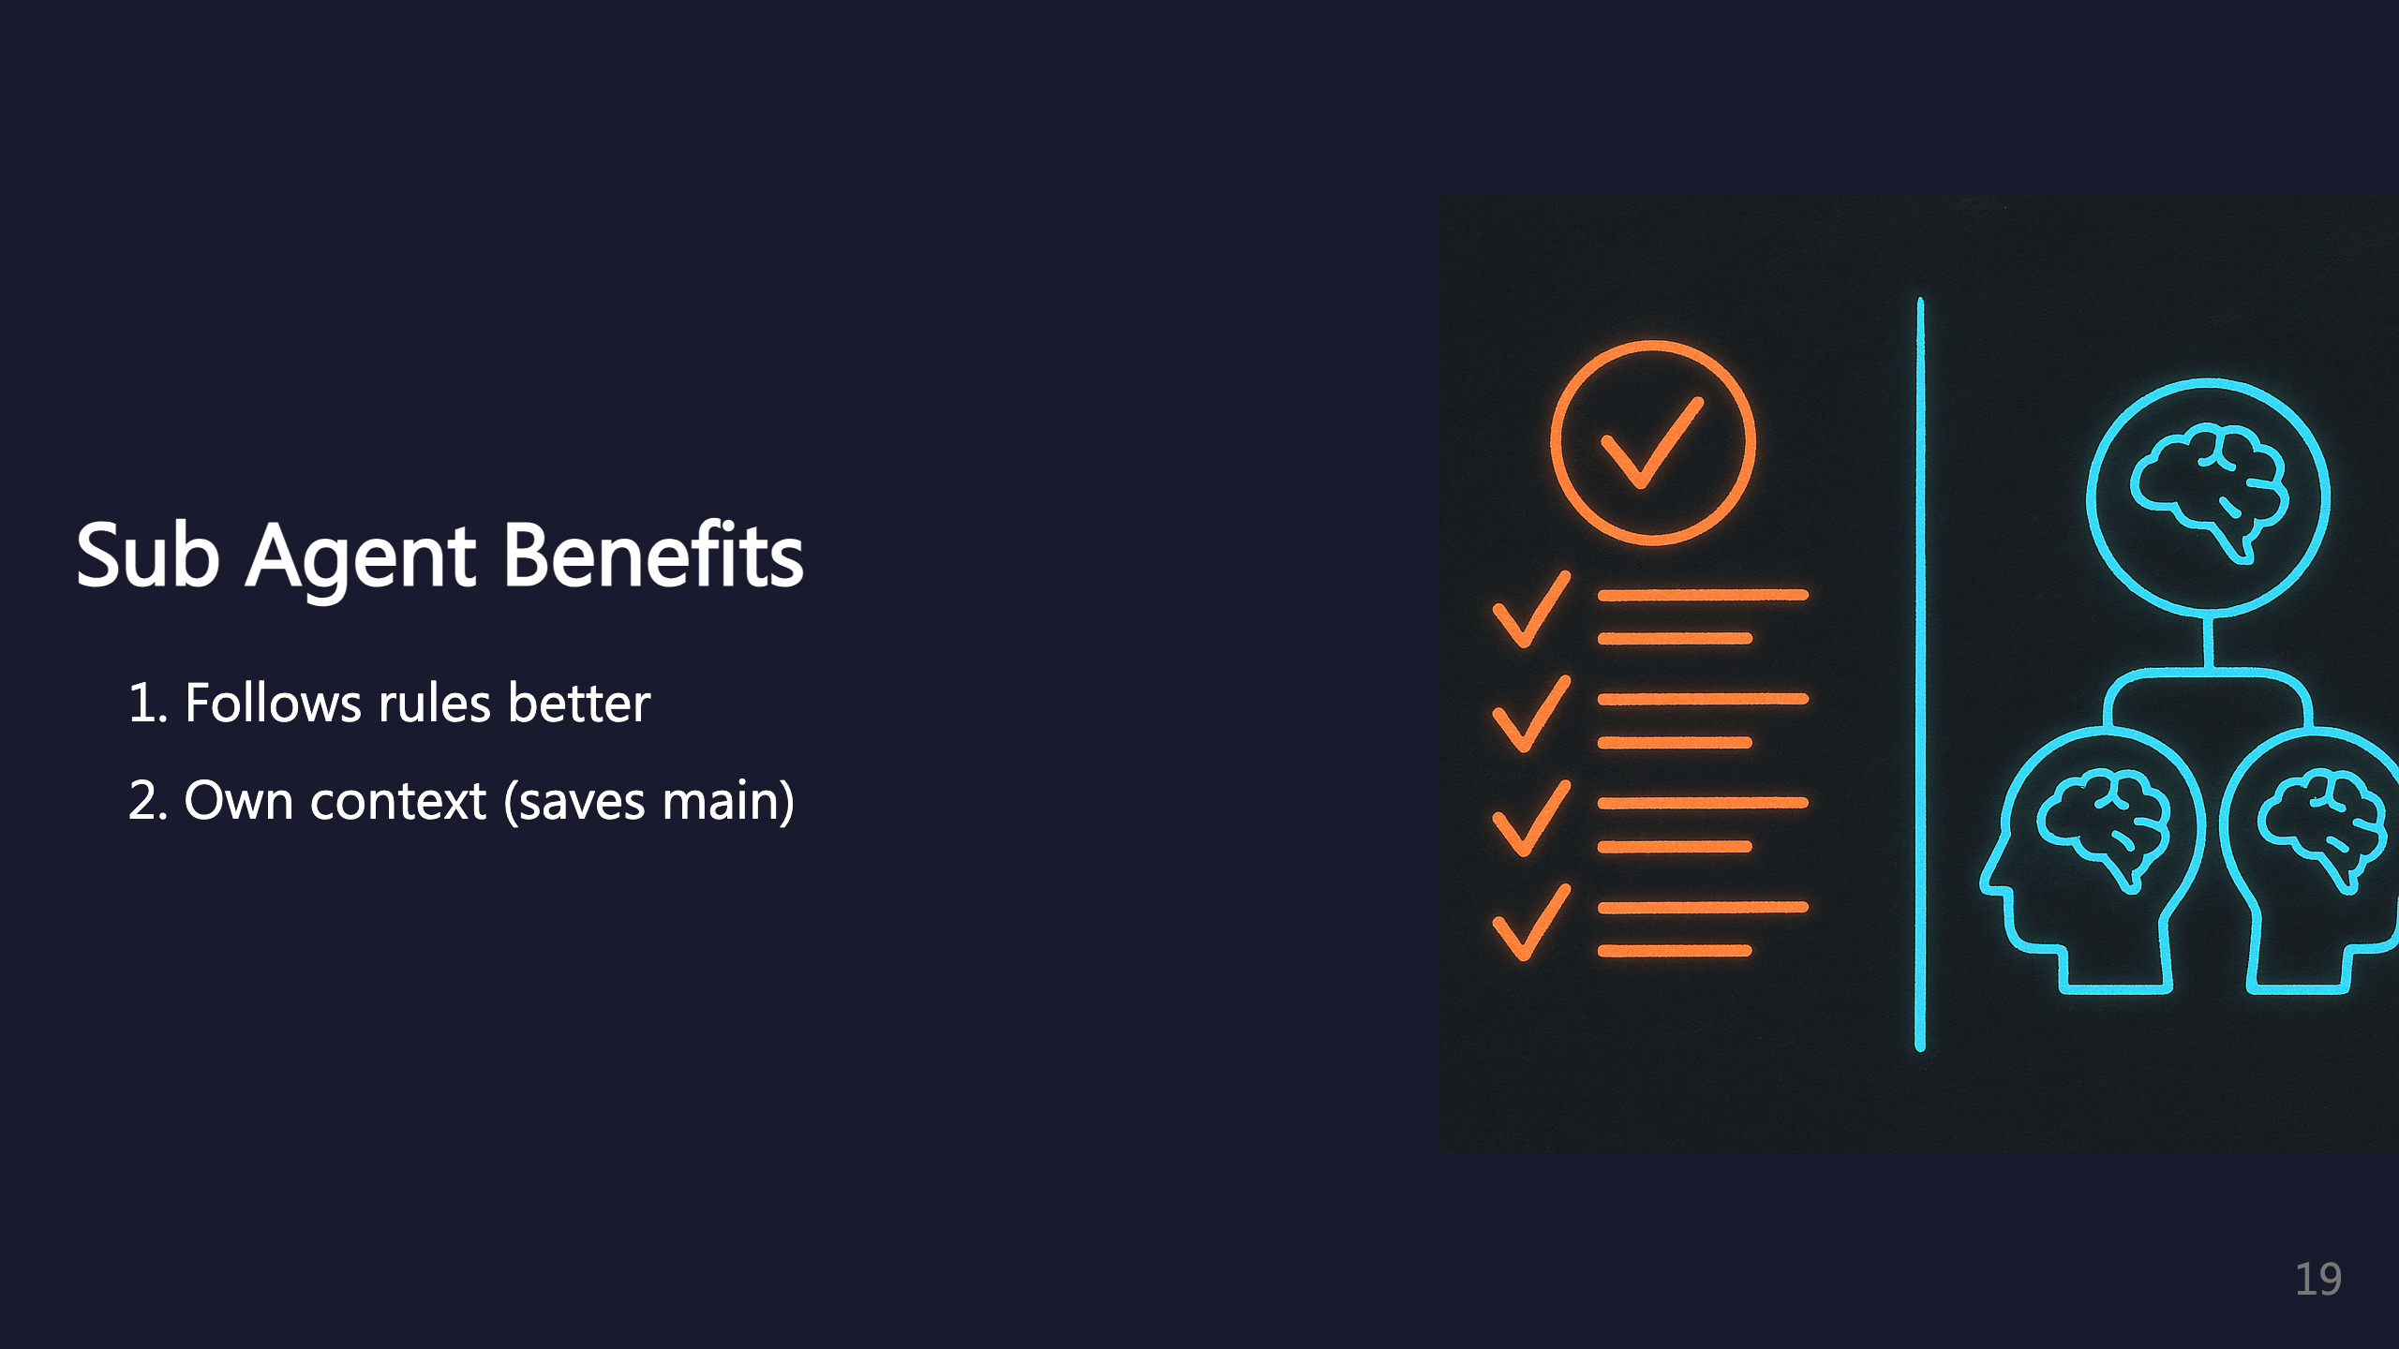
Notes:
Sub agents stick to rules better with specialized instructions. They don't exhaust main thread context since they have their own. _transition: push

Slide 20

Notes:
Model Context Protocol plugins extend Claude's capabilities.

Slide 21
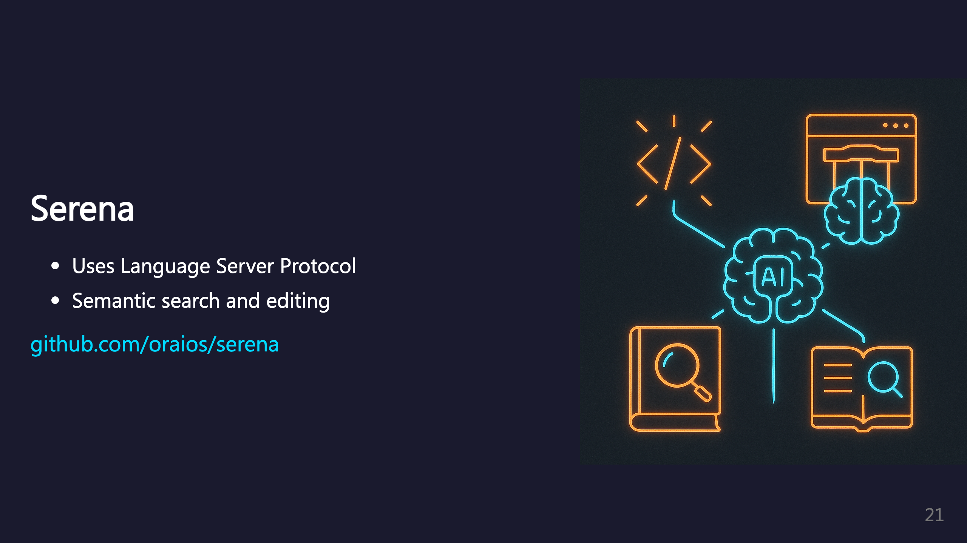
Notes:
Serena uses LSP to do semantic search and editing of code.

Slide 22
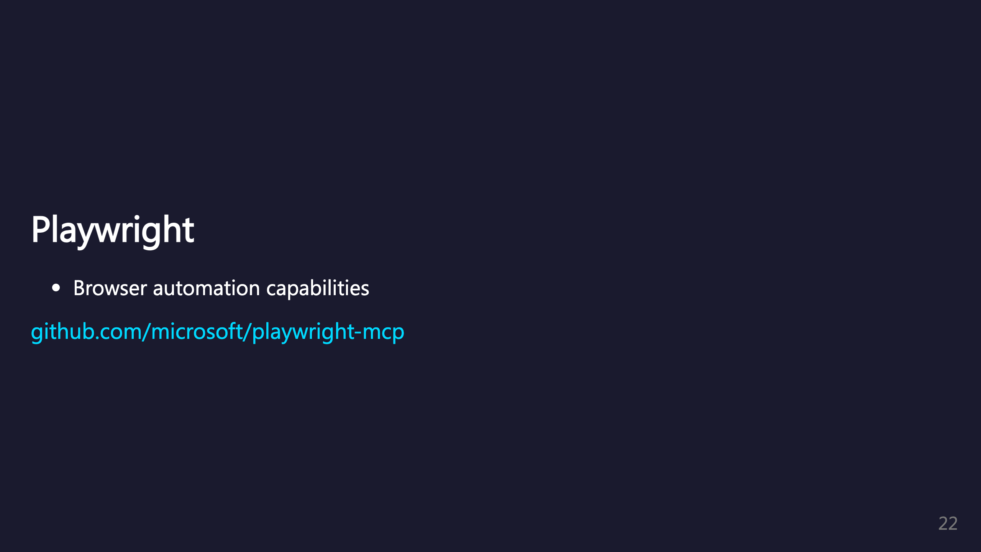
Notes:
Playwright MCP provides browser automation capabilities.

Slide 23

Notes:
Context7 exposes tools to search up-to-date documentation. _transition: push

Slide 24

Notes:
Additional plugins that enhance Claude Code.

Slide 25

Notes:
Superpowers provides a bunch of skills to Claude to use.

Slide 26
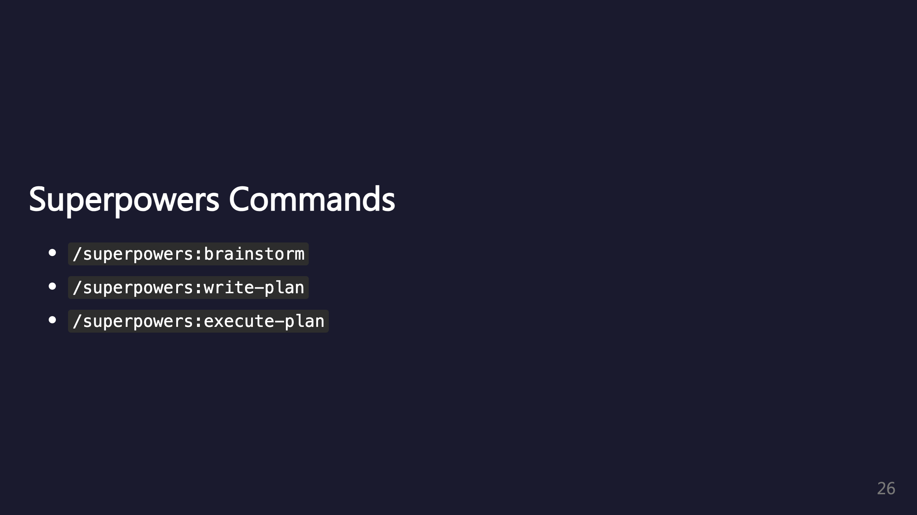
Notes:
brainstorm: Interactive design refinement using Socratic method write-plan: Create detailed implementation plan with bite-sized tasks execute-plan: Execute plan in batches with review checkpoints

Slide 27
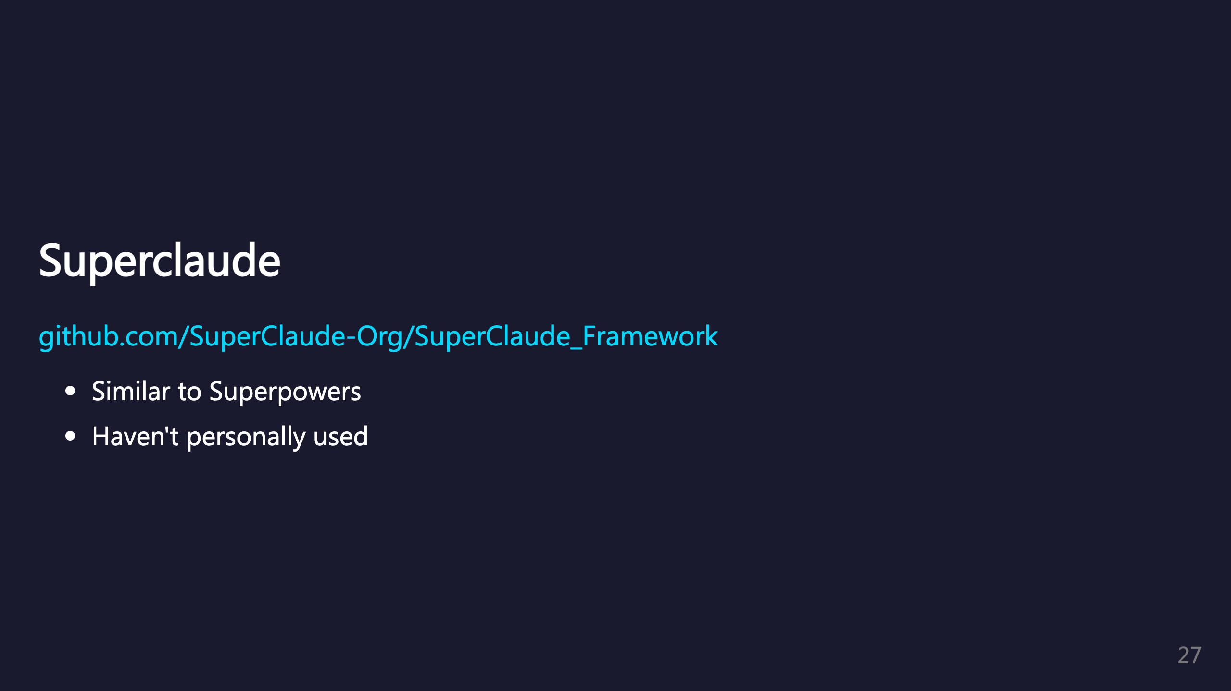
Notes:
Similar to Superpowers. I personally haven't used it. _transition: push

Slide 28
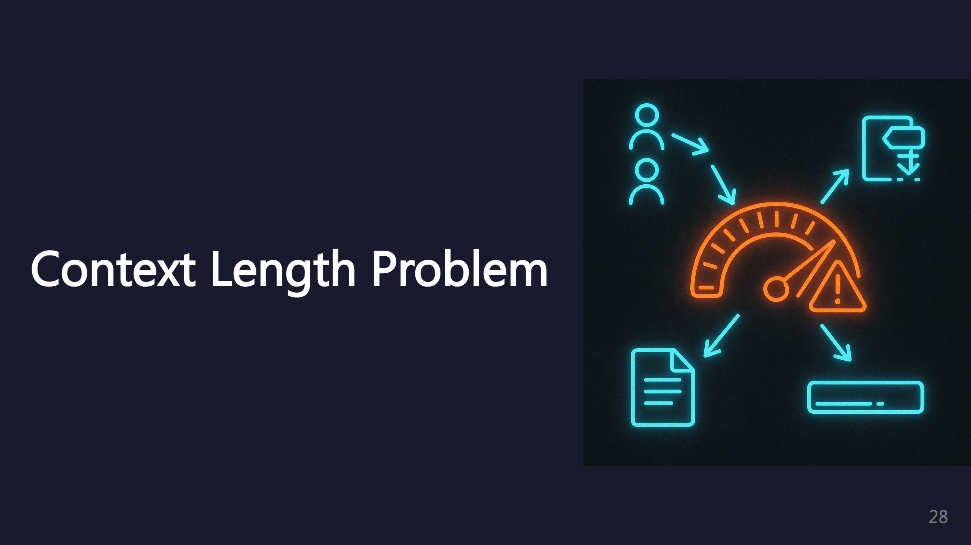
Notes:
Managing context length is crucial for long sessions.

Slide 29
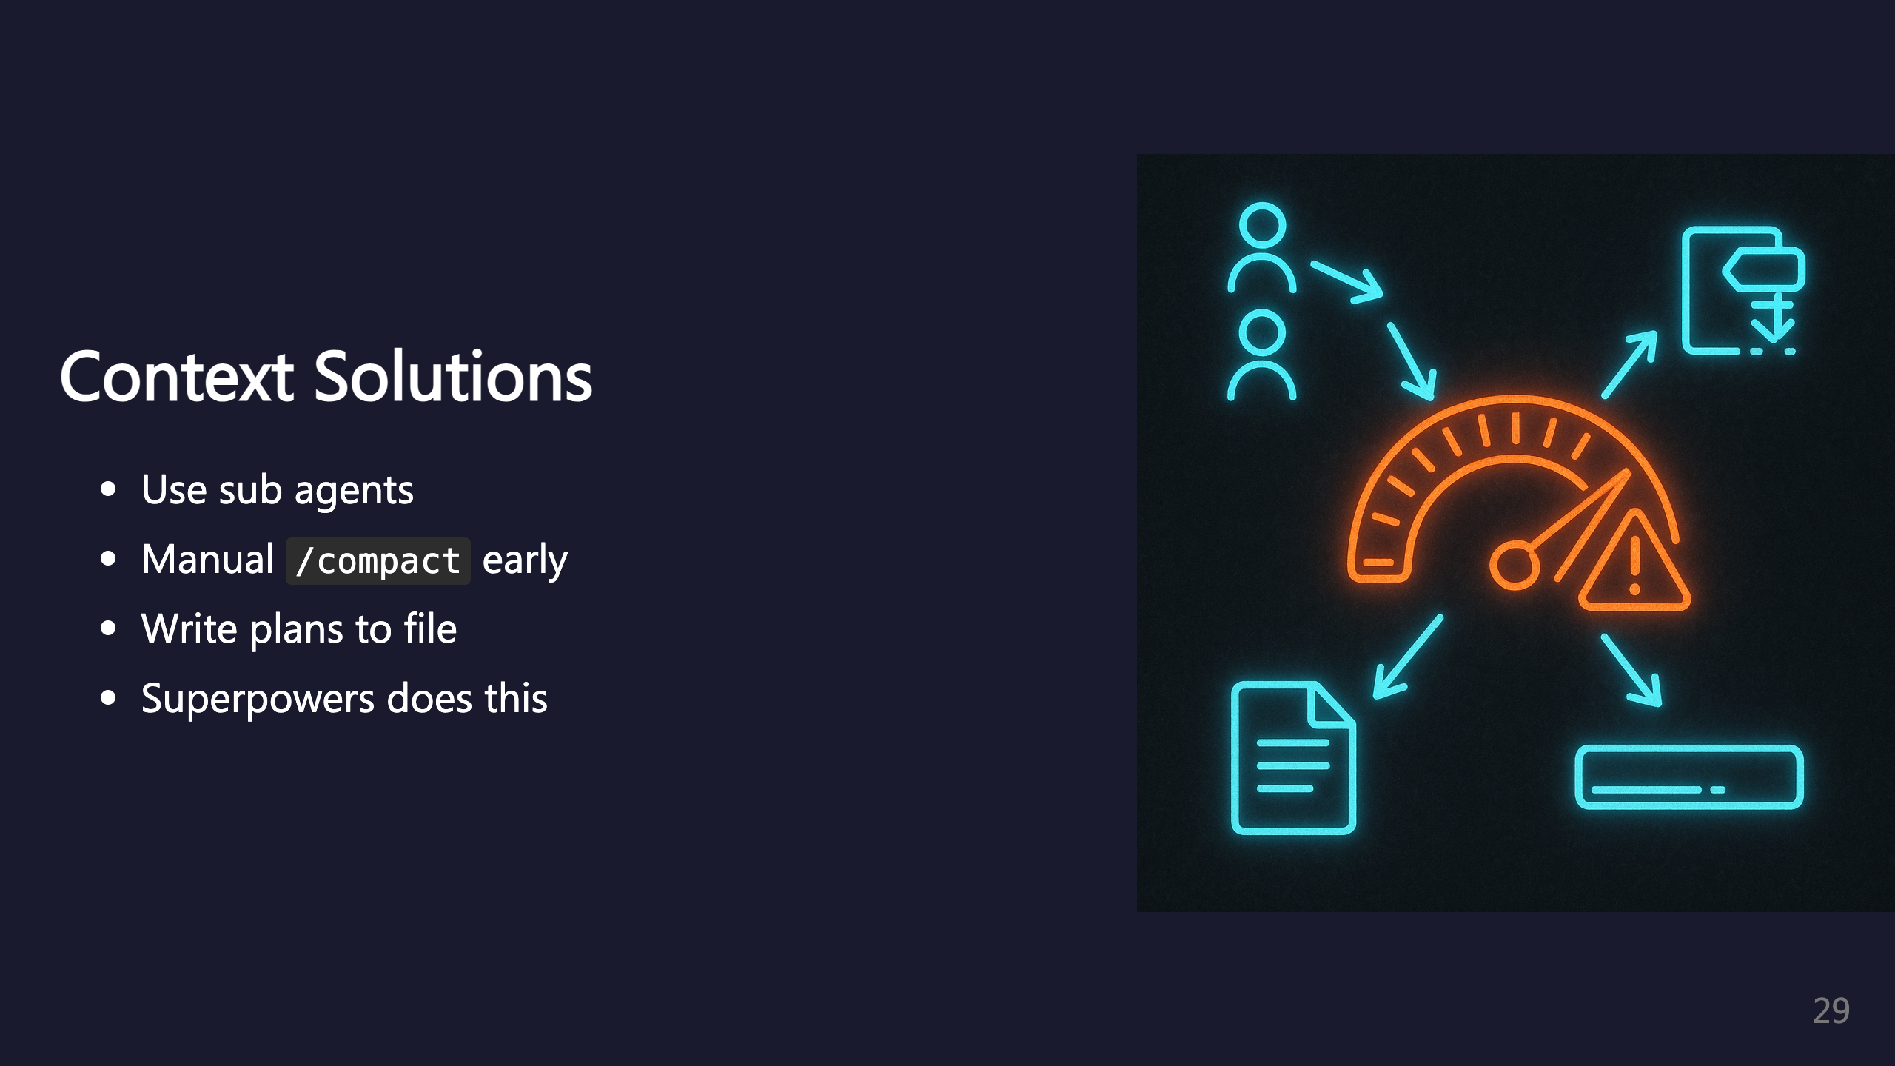
Notes:
Use sub agents to offload context. Compact manually instead of waiting for automatic compaction at a bad time. Get Claude to write plans to file before execution so work can be resumed.

Slide 30
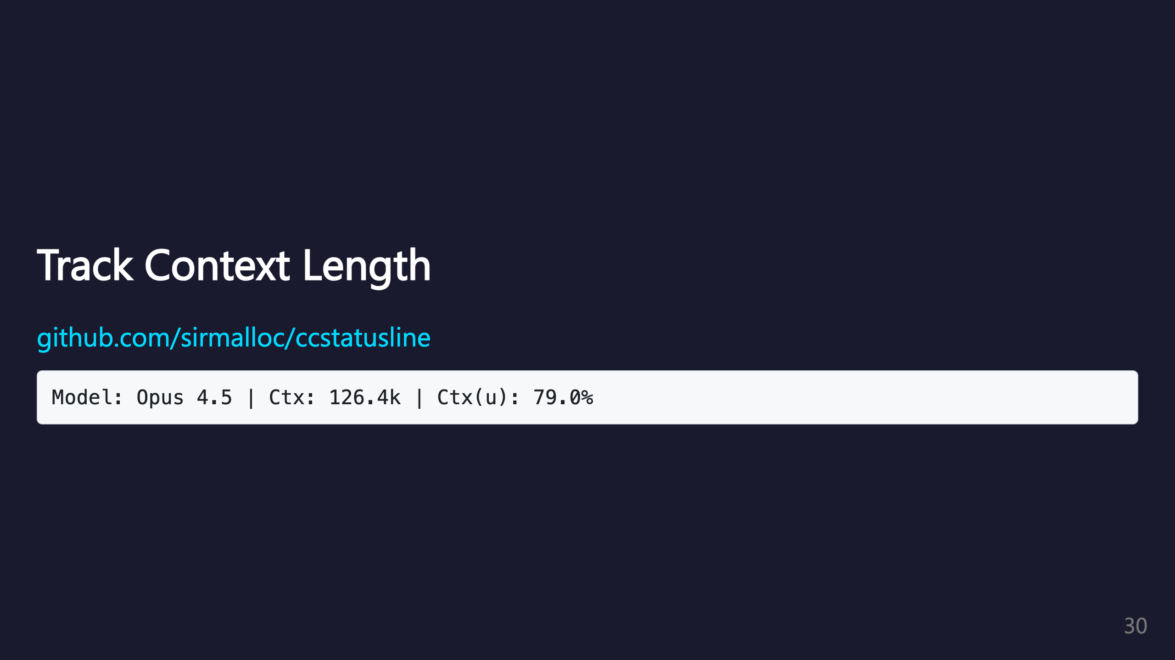
Notes:
Use ccstatusline to track context usage in your status line. Shows cwd, model, context size, and percentage used.

Slide 31

Notes:
TODO section - content to be added.

Slide 32

Notes:
TODO section - content to be added.

Slide 33

Notes:
TODO section - strategies for when Claude goes in circles.

Slide 34

Notes:
TODO section - content to be added.

Slide 35

Notes:
TODO section - specific guidance for Ailo repos. _transition: fade-out

Slide 36

Notes:
Thank you for attending. Questions welcome!

